Slide 1
Dynatrace Associate Certification Preparation
April 16, 2019

Slide 2
Exam Format
Web-based, 70 questions, 105 minutes
Passing score is 72%
Multiple-choice
Pick one right answer from A, B, C, D
Multiple-response
Select all right answers from a list of options

Slide 3
Knowledge Area | %
Capabilities & Monitoring | 27%
Components & Architecture | 16%
Problems & Resolution | 10%
Reporting & Analysis | 16%
Real User Monitoring | 17%
Synthetic Monitoring | 14%
Total | 100%

Slide 4
Capabilities & Monitoring
OneAgent capabilities:
On a host: CPU, memory, network traffic, disk space, OS, key processes, virtualization, IP address, cloud information
Tagging in Dynatrace
Can be applied to hosts, processes, services and applications
Can be imported from AWS
Can be added manually or automatically using rules
Can be used as filter (even in search function)
Can be used for custom grouping
Key: Can tag processes and process groups!
Metadata ≠ tags! Metadata is info about deployed application
Docker monitoring
Just install on the host with Docker containers
Automatically enabled OOTB

Slide 5
Capabilities & Monitoring
Network monitoring overhead
>5% CPU, network monitoring is disabled
Resumed once <5% (traffic reduces)
Database monitoring
OOTB Dynatrace monitors database calls from the calling process at application side
i.e. ADO.NET, JDBC, Node.js or other processes making database calls
Does not instrument the database process
Optional to install OneAgent in database but can add additional context (infra and process metrics)

Slide 6
Capabilities & Monitoring
Install OneAgent -> Enable deep monitoring by restarting JVM or app pool
Can connect to only one Dynatrace tenant (the one you downloaded from)
Disable OneAgent automatic updates
Global setting
Host-specific
Disable monitoring of application, e.g. .NET or Java
Global setting > Monitored Technologies > Off/On
Browser clickpath requirements
Only Google Chrome
Must have Synthetic Recorder plugin installed

Slide 7
Capabilities & Monitoring
Service identifying and detection
Web server name
Context root
Web application ID
Opaque service which code visibility not available, mainly due to technology support
Custom service detection
Create entry point via specific class method
Database service detection
DB name/schema
Vendor (e.g. MSSQL, Oracle…)
IP and port
Process detection
Usually automated
Can create own process group detection rules

Slide 8
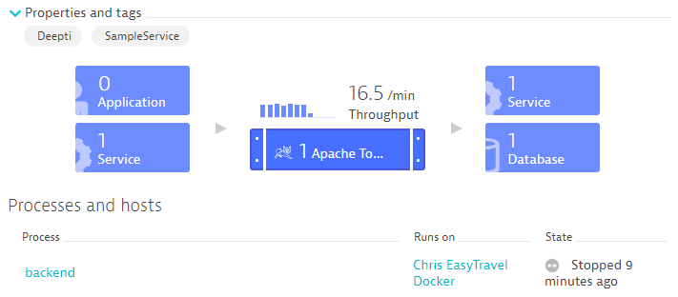
Reporting & Analysis
Infographic for SERVICE

Slide 9
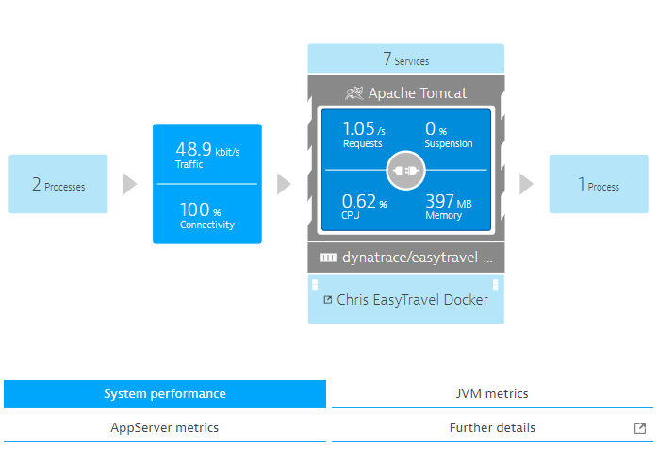
Reporting & Analysis
Infographic for PROCESS

Slide 10
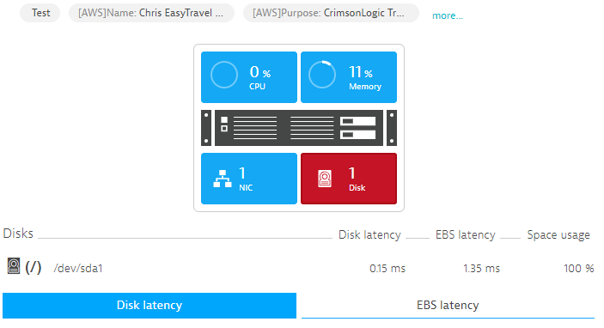
Reporting & Analysis
Infographic for HOST

Slide 11
Components & Architecture
What is Smartscape
Visualization of the topology and dependency of all entities discovered in the observed environment
Solid line connection – active communication
Dashed connection – there has been communication, not now
What is PurePath
Single transaction diagnostic information
Accurate performance measurement and root cause analysis
What is Services
Services that process requests like web requests, web services, RMI, even databases, and span across instances
Key functions of an ActiveGate
Firewall rules
OneAgent traffic bundling
vCenter (No need to install OneAgent on the ESXi host!), AWS, Azure monitoring
Mobile, Agentless RUM, Synthetic Monitoring
Optional component but best practice

Slide 12
Components & Architecture
Two types of ActiveGates:
Environment -> belongs to specific tenant
Cluster -> shared across tenant
External Service (Requests to unmonitored host / Monitoring candidate)
Does not have OneAgent installed
Called by application or service that is monitored by OneAgent
RUM
Once enabled, the web page source contains a ruxit JS
Why agentless RUM monitoring
No way of installing OneAgent on webserver!

Slide 13
Components & Architecture
Two flavors
Dynatrace SaaS
Dynatrace Managed
On-prem
Must have outbound communication to mission control
Health monitoring
License validation
Automatic updates

Slide 14
Components & Architecture
Dynatrace AI-powered root cause analysis
Dependencies between components
A dependency model is built
Deterministic AI to analyze cause and effect relationships in the model
Network monitoring metrics are important because…
Part of underlying infrastructure
Can be a root cause for performance issue
Virtualization monitoring is important because…
Part of underlying infrastructure…
Performance of virtualization hosts can affect VMs -> application performance
Part of the dependency model

Slide 15
Components & Architecture
Data Retention - Timeseries metrics
1 minute granularity – 14 days
5 minute granularity – 28 days
1 hour granularity – 400 days
1 day granularity – >400 days
https://www.dynatrace.com/support/help/deploy-dynatrace/oneagent/capabilities/data-retention-periods/

Slide 16
Components & Architecture
Users and rights in Dynatrace Managed
A default administrator account is created upon installation
An user can be assigned as Cluster administrator
Cluster administrator allows access to the entire Dynatrace cluster settings
Users can be assigned to specific environments and not others
All type of rights will at least allow access to the Dynatrace Managed server

Slide 17
Components & Architecture
AWS Cloudwatch integration
Manually connect Dynatrace to Amazon account
Provide authentication information (role-based, key-based)
Dedicated AWS environment dashboard in Dynatrace
Might not be FREE! (charged by AWS)
PaaS monitoring
Get PaaS token
Get CLI
Create Dynatrace service in Cloud Foundry environment
Bind Dynatrace service to your application
https://www.dynatrace.com/support/help/cloud-platforms/cloud-foundry/application-only/deploy-oneagent-on-cloud-foundry-for-application-only-monitoring/

Slide 18
Problems & Resolution
Problem and anomaly detection
Automatic baselines
Available 2 hours after application or service has been first detected
User-defined thresholds
Built-in thresholds (for infrastructure monitoring)
Thresholds can be edited globally or individually
Use case 1: increase threshold in pre-prod
Use case 2: lower threshold for mission-critical services
Application baselining
User actions duration
Traffic drops + spikes
Failure rate
Database baselining
Response time
Failure rate
Failed database connects
Install Dynatrace mobile app for problem notification

Slide 19
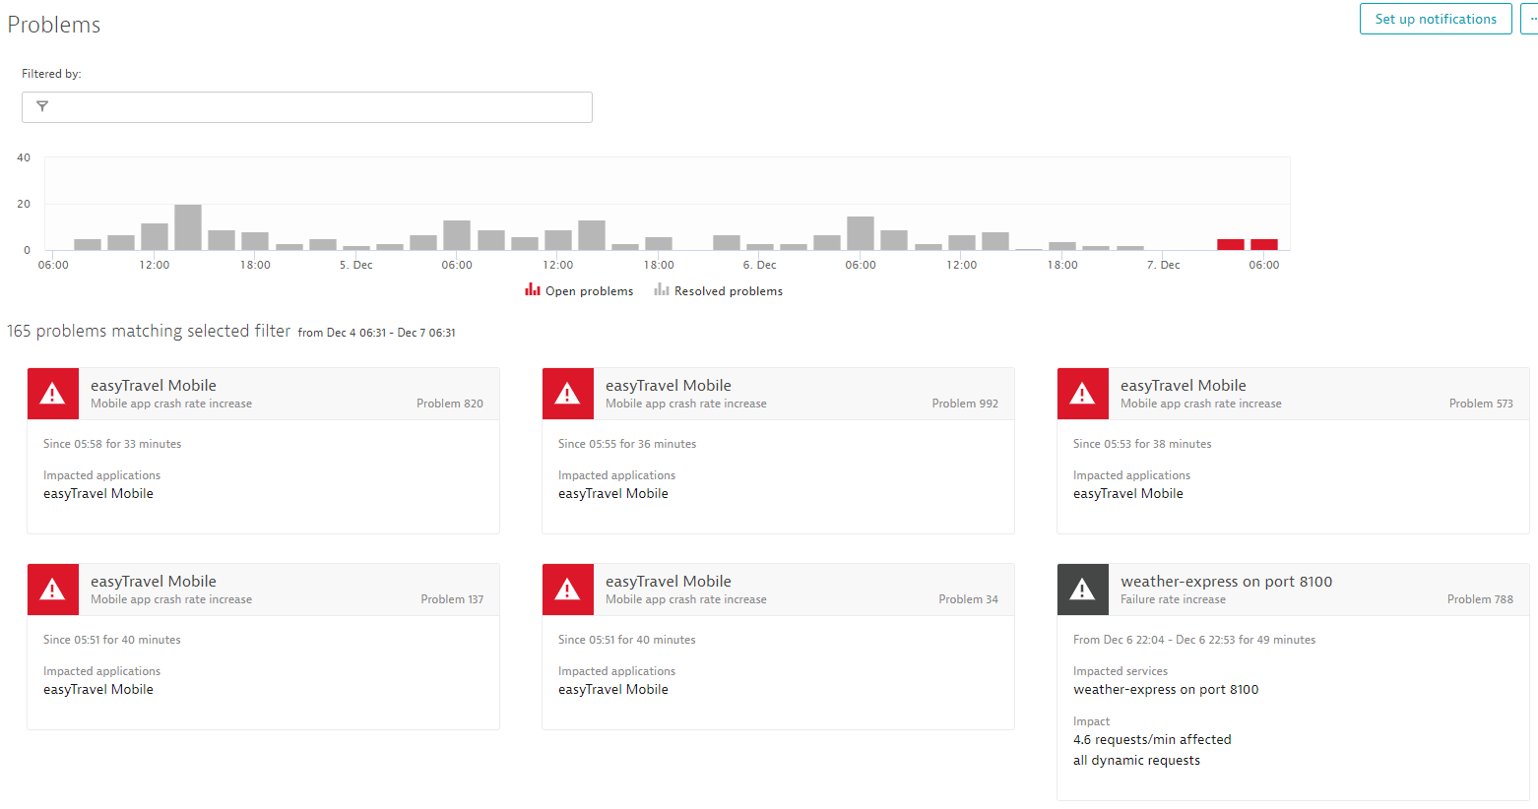
Trend of number of problems

Slide 20
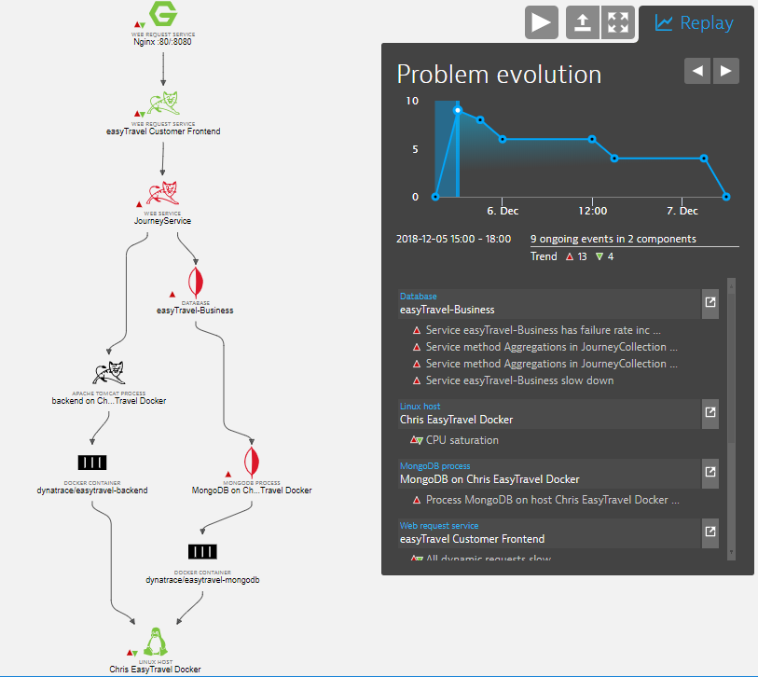
Problem evolution and affected services: use Visual Resolution Path!
Impact to the front-end?
What is the nature of the problem?

Slide 21
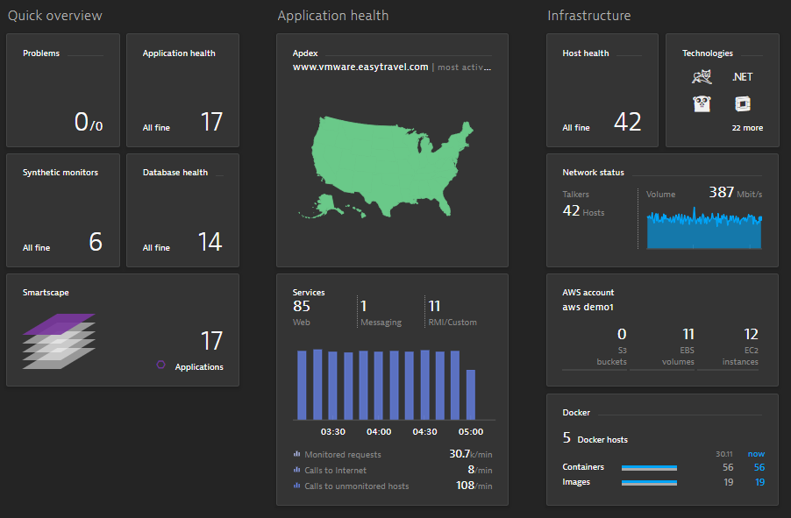
Information on this dashboard
What other network metrics by clicking it?
Total containers and images, not average!

Slide 22
Information on this dashboard
Which country is affected?

Slide 23
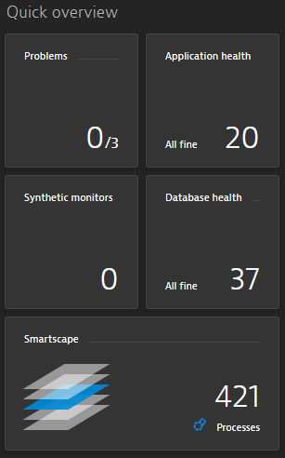
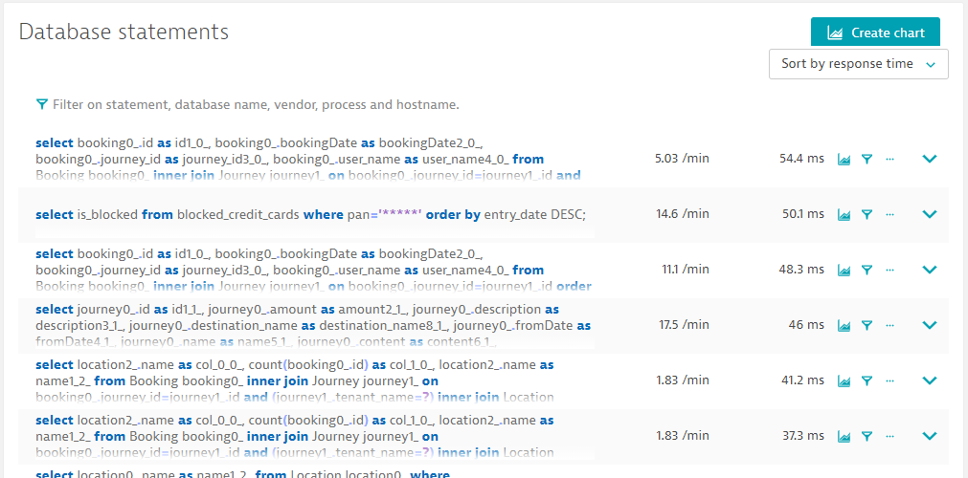
Reporting & Analysis
Database tile -> database calls

Slide 24
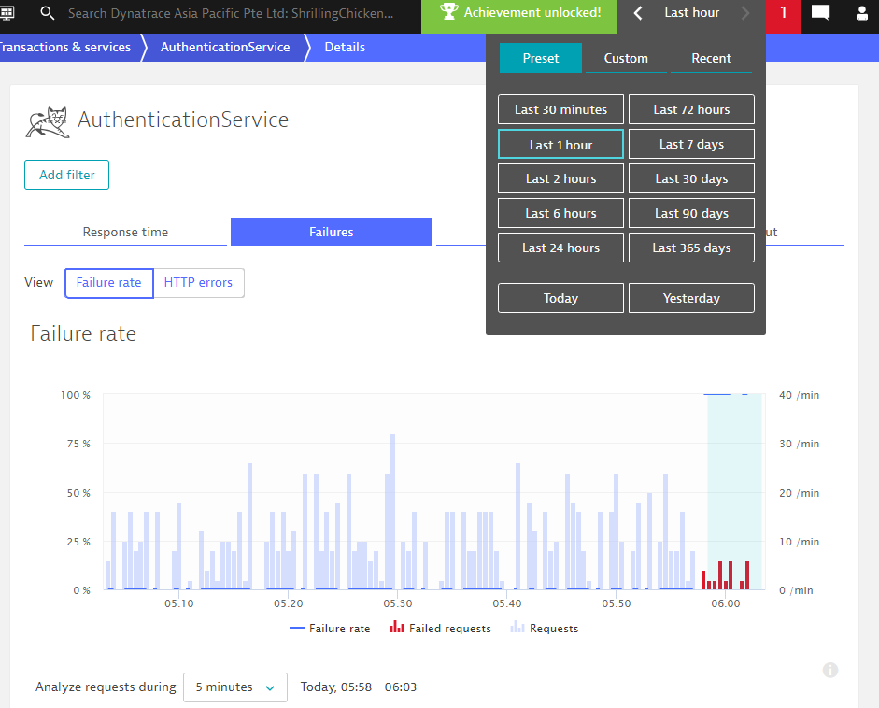
Time frame selector

Slide 25
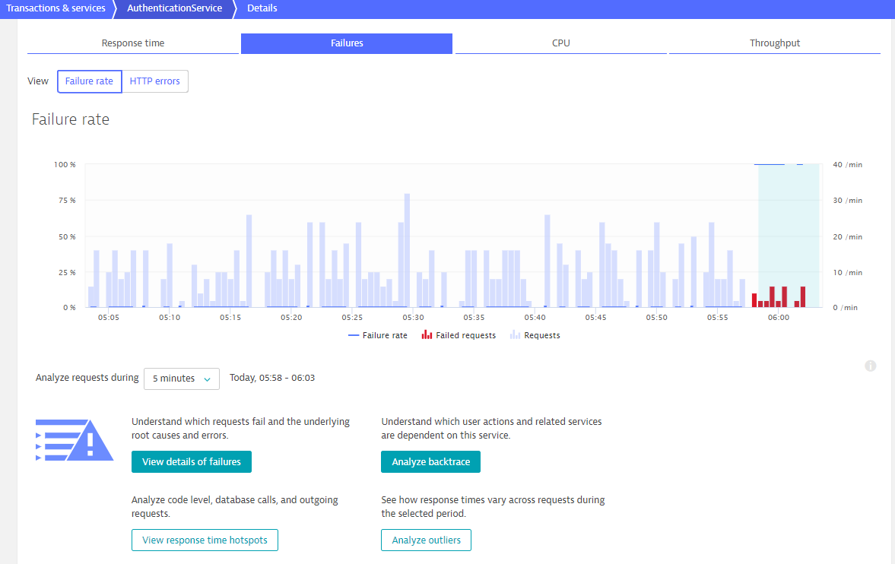
Analyze slow requests

Slide 26
Reporting & Analysis
Service flow
Applications or services and their calls to other back-end services or databases
Automatic hotspot analysis
Slowest requests
Most time consuming requests
Most CPU intensive requests

Slide 27
Reporting & Analysis
Your dashboard – sharing is caring!
Can create multiple dashboards
Dashboard tiles can be added and re-arranged
Log analytics
Investigate crashed process
Mobile app crashes details in application details page
Service Quality Report
Weekly occurrence
Dynatrace score = Applications + Services + Infrastructure score
Infrastructure score = % of host time during which no problems were encountered
Services score = % of successful service calls that were unaffected by problems
Application score = Apdex + % of user actions affected by problems

Slide 28
Real User Monitoring
User action
Automatically detected, assigned to applications
Key user action
Extends data retention time
Can be pinned to dashboard for monitoring

Slide 29
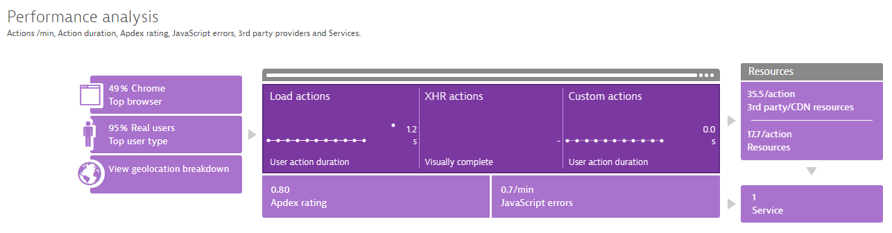
Real User Monitoring
Infographic for APPLICATION

Slide 30
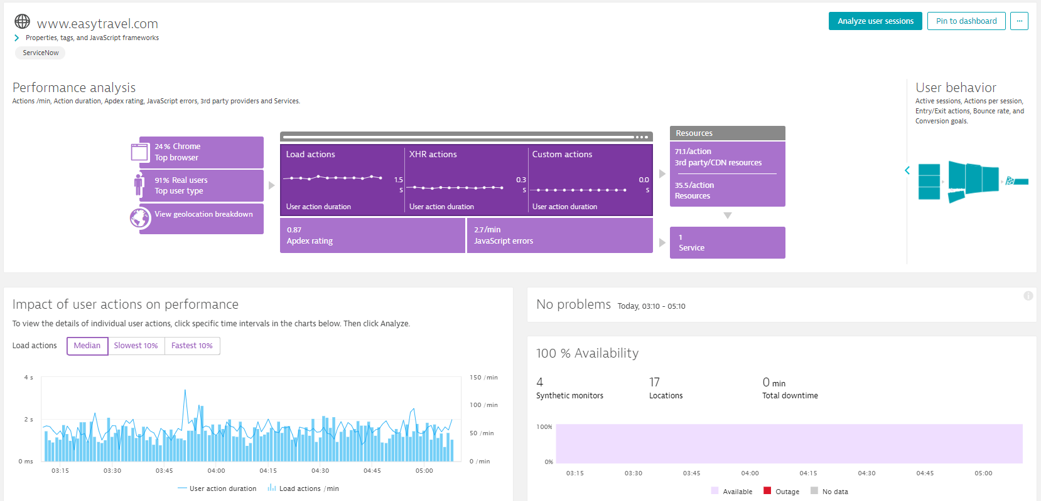
Top browser and user type
Web checks (browser clickpath)

Slide 31
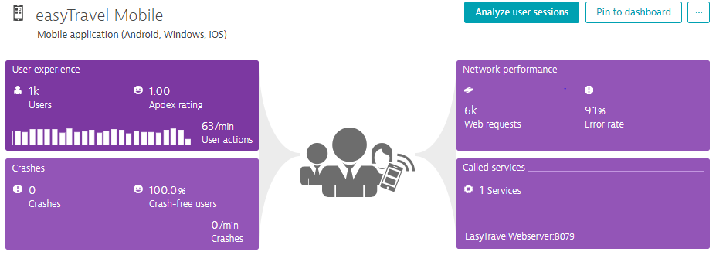

Slide 32
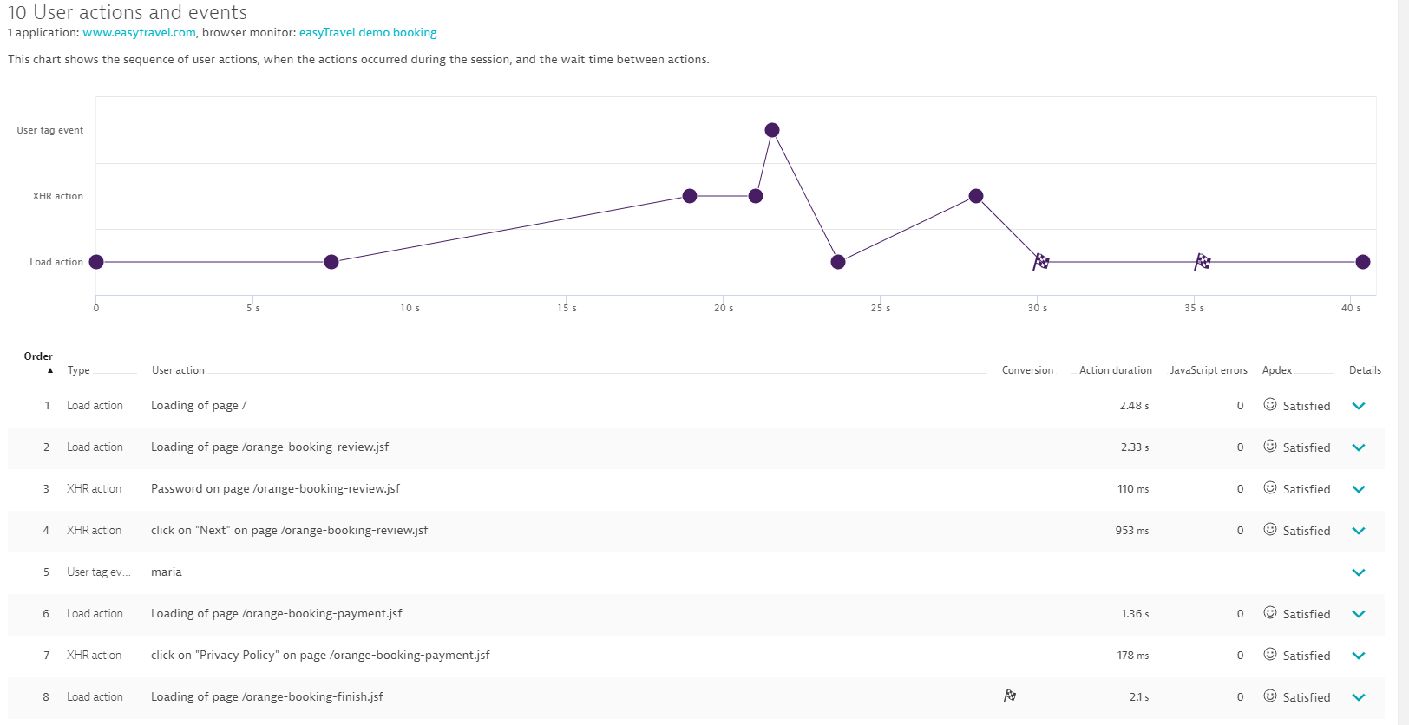
Conversion goal
JS error?
Type of actions (load, XHR)
Action response time

Slide 33
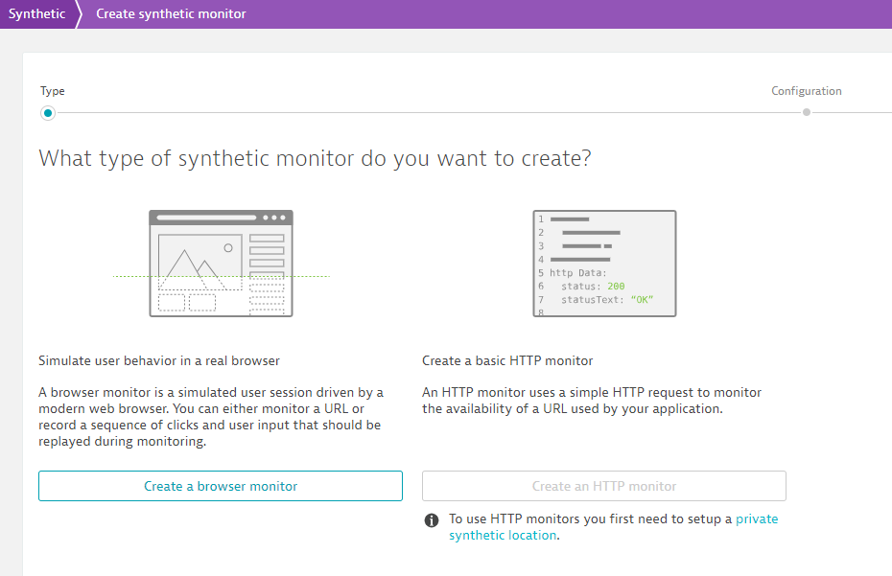
Synthetic Monitoring
Creating a Synthetic Test

Slide 34
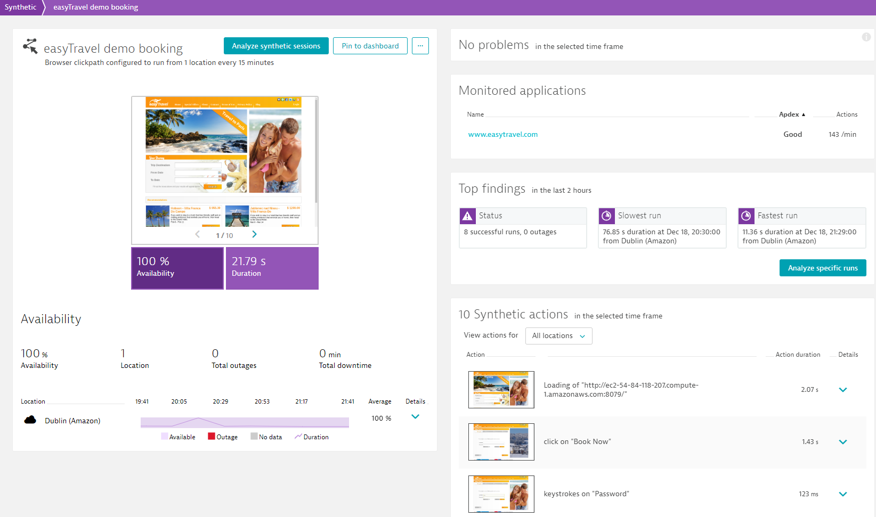
Synthetic Monitoring
Analyze data gathered by synthetic monitor

Slide 35
All the best!

